Slide 1
Selenium WebDriver
Basics & Creating a test

Slide 2

PURPOSE
To create your first test and learn some basic commands

Slide 3
Objective
To create your first test.

Slide 4
Creating a test – The Order
Create a WebDriver reference – Coding to an interface
Set the System Property (Or multiple) for the driver you’ll be using.
Instantiate your WebDriver as the implementation you’ll be using (Chrome, firefox, etc.)
Load a WebPage with webDriver.navigate.to(String url) on your WebDriver
Do your test.
Close the driver.

Slide 5
Creating a test - Example
public class GoogleSearch {
static WebDriver driver;
public static void main(String[] args) {
System.setProperty("webdriver.chrome.driver",
"C:\\Users\\ewomack\\Desktop\\java\\selenium\\chromedriver.exe");
driver = new ChromeDriver();
driver.navigate.to("http://www.google.com/");
boolean result = true;
try {
driver.findElement(By.name("q"));
}
catch (NoSuchElementException e) {
System.out.println(e);
result = false;
}
finally {
driver.quit();
}
if (result)
System.out.println("---Passed---");
else
System.out.println("---Failed---");
}
Notes:
Depending on how eclipse is set up it should automatically import everything, if not hover over the errors and import them one by one.
Example test of loading up google and checking that the element is there with the name of q.

Slide 6
By
Method Call | Description
By.name(String) | Find elements based on their name
By.id(String) | Find elements based on their ID
By.className(String) | Fid elements based on the value of the class attribute
By.linkText(String | Find elements based on their linktext
By.XPath(String) | Find elements using xpath
By.CSSSelector(String) | Find elements via their css
By.partialLinkText(String) | Find elements that contain the given link text
By.tagName | Find elements via their tag name.
Notes:
By is a class with a bunch of static methods that let us retrieve elements in a multitude of ways.

Slide 7

Objective
Learn to use Firebug to locate elements

Slide 8
Firebug - Introduction
Firefox Plugin
Lets you view the contents of a webpage efficiently
Just shows you want you want to see.
Can view
Scripts
HTML
CSS
DOM
Console
Cookies
Network requests
Notes:
Whilst you can do loads with firebug, we’re only interested in looking at tags so then we can work with them in Selenium.

Slide 9
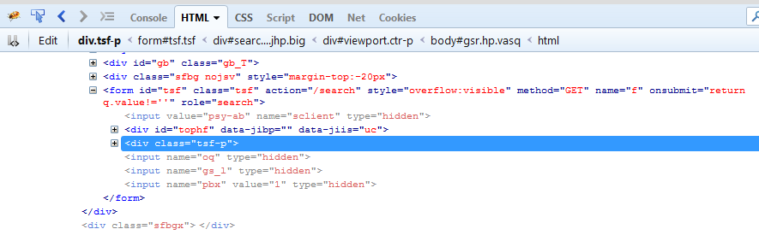
Firebug - Introduction
Notes:
Back/forward lets you navigate between your most recent tabs/selections
Console/html/css/script/dom/net/cookies lets you view that aspect of the page
div.Tsf to html refers to the hierarchy of the tag you have currently selected, letting you jump up and down through it.

Slide 10
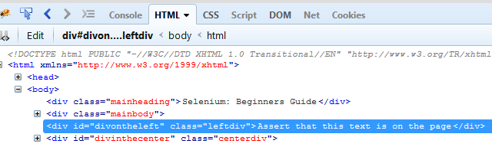
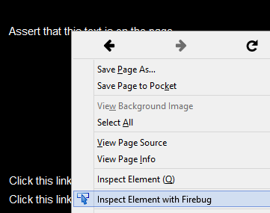
Firebug - Example
Notes:
http://book.theautomatedtester.co.uk/chapter1
Manually finding verifying elements with firebug

Slide 11
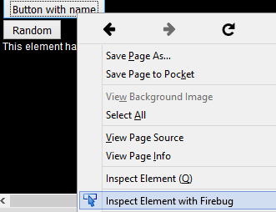
Firebug - Example
Notes:
http://book.theautomatedtester.co.uk/chapter2
Also works with names, and links (As well as others to come)

Slide 12
XPath – What is it?
XPath is used to navigate through elements and attributes in an XML document.
Stands for XML Path Language.
Utilises ‘path like’ syntax to identify and navigate through nodes in an XML document.
W3C Recommendation.
Major element in the XSLT standard.

Slide 13
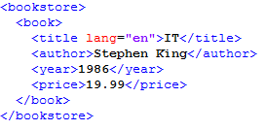
XPath - Keywords
Nodes
Element
Attribute
Text
Namespace
Processing-instruction
Comment
Document nodes
XML Documents are treated as a tree of nodes.
The topmost element of the tree is called the root element.
<Bookstore> (root node)
<author> Stephen King</author> (element node)
Lang=“en” (attribute node)

Slide 14
Selecting Nodes
XPath uses path expressions to select a node from an XML Document.
Below are some of the more common expressions
Expression | Description
nodename | Selects all the nodes with the name “nodename”
/ | Select from the root node
// | Selects nodes in the document from the current node that match the selection no matter where they are
. | Selects the current node
.. | Selects the parent of the current node
@ | Selects attributes

Slide 15
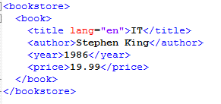
Examples
Expression | Result
bookstore | Selects all nodes with the name “bookstore”
/bookstore | Selects the root element bookstore
bookstore/book | Selects all book elements that are children of bookstore
//book | Selects all book elements no matter where they are
bookstore//book | Selects all book elements that are in bookstore
//@lang | Selects all attributes that are named lang
Notes:
If a path starts with a slash ( / ) it always represents an absolute path to the element
More examples:
https://www.w3schools.com/xml/xpath_syntax.asp

Slide 16
Exercise
Using basic Java programming, Firebug and By selectors, create a test using each By Selector on the following website.
http://book.theautomatedtester.co.uk/chapter1
Verify multiple elements (Or the same element in different ways) using the By Selectors provided
Notes:
http://book.theautomatedtester.co.uk/chapter1

